Slide 1

深度学习
演示人：王泽坤

Slide 2

目录
01.
《机器学习》(周志华)
02.
卷积神经网络
03.
Tensor Flow 2.0
04.
项目理解

Slide 3
卷积神经网络--经典模型
LeNet-5
由几组不同卷积核设置下的卷积层和池化层交替连接后，再接全连接层构成的
AlexNet
和LeNet-5结构相似，充分利用了多GPU加速
KEY WORDS
VGG-16(19)
结构更简单，更能关注卷积层，真正的简化了神经网络结构

Slide 4
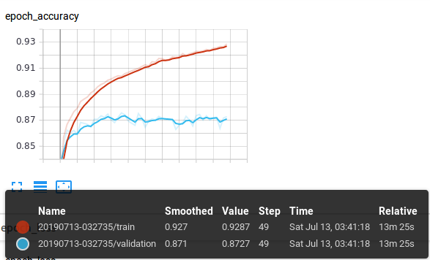
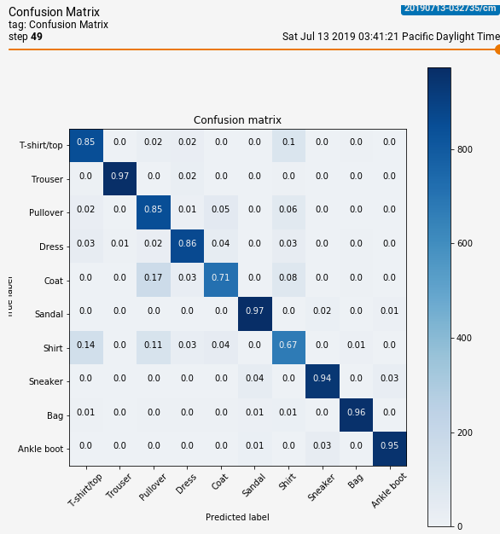
CNN & FC
Full Connected
9%
KEY WORDS

Slide 5
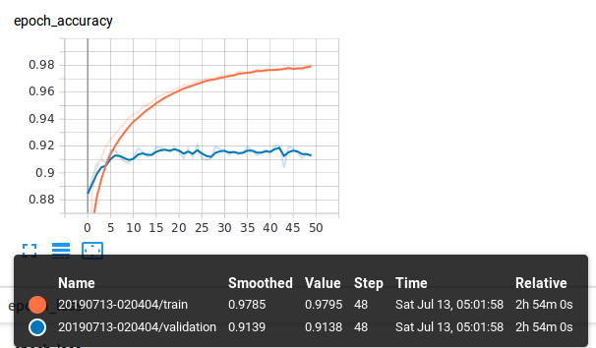
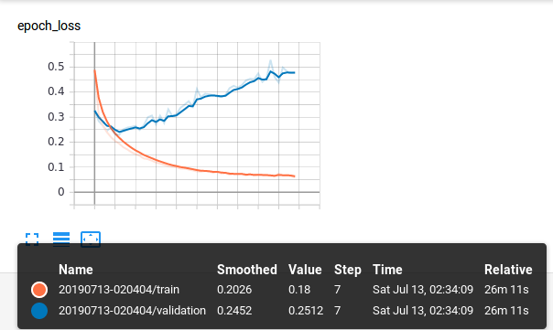
The user can perform the presentation on a projector or computer, and the powerpoint can be printed out and made into film
CNN & FC
Convolutional Neural Networks

Slide 6
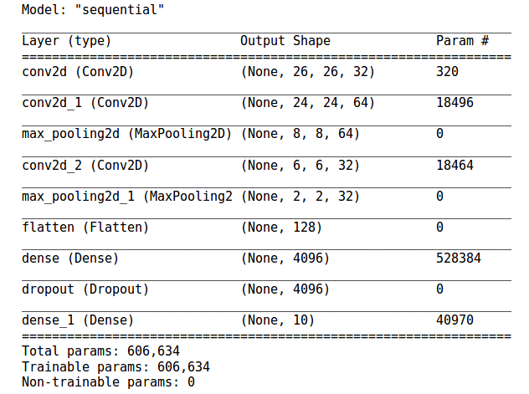
The user can perform the presentation on a projector or computer, and the powerpoint can be printed out and made into film
CNN Summary

Slide 7
The user can perform the presentation on a projector or computer, and the powerpoint can be printed out and made into film
Embedding Projector

Slide 8
项目理解
01.
深度学习
02.
强化学习
03.
基于知识的学习
04.
KEY WORDS
麻将教学(解释原理)
05.
对手模型

Slide 9
感谢观看！

